Slide 1


Slide 2
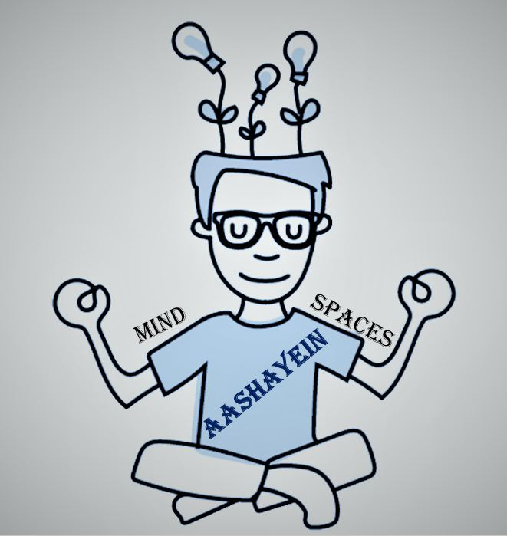
TEAM -Spacex
Please mention the following:
1. Team Name - SpaceX
2. Team Lead –Meghana deshpande ,Priyanka Nayek , Pradheeba Dharmapandian , Sachin Soni , Doshi Ashish
3. FIS global Pune ,India
4. The name of your idea -Aashayein
5

Slide 3
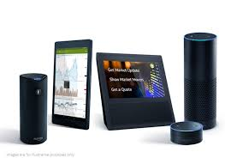
Problem Statement
Need of the hour is integrated platform for mind sustainability and trustworthy real time 24/7 support in pandemic . Also for special abilities people who need some help at one integrated platform.
The COVID-19 pandemic has had a major effect on our lives. Many of us are facing challenges that can be stressful, overwhelming, and cause strong emotions in adults and children. Public health actions, such as social distancing, are necessary to reduce the spread of COVID-19, but they can make us feel isolated and lonely and can increase stress and anxiety. Learning to cope with stress in a healthy way will make you, the people you care about, and those around you become more resilient.
Aashayein app is buddy to every one around with its Features healing tool,Buddy talking with anytime all time with ROBOT ,Notification statistical information around ,children well being.

Slide 4
Proposed solution
WWW.AASHAYEIN.in is all about taking and talking to mind spaces to heal and have great healthy life in mind and body. Aashayein is about sustainable shopping amazon for Mind.
Its integrated platform for various stress release techniques such as robot chat bot 24/7 and talking with user , various features
The enhanced version of aashayein Robot chat bot can be used by special disabilities people to talk with robot in sign language and robot can interact with the users in sign language.
Its webportal converted app which can be accessed from user mobile and PC.
Its solution at fingertips for stress mind also can be accessed by your voice commands .It integrated using ALEXA webapi voice control .
Where the user gives commands access Features and tools for healthy sustainable life style.
It has features which are integrated micro web services such as you tube , ted talk one at one platform.

Slide 5

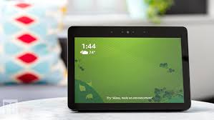
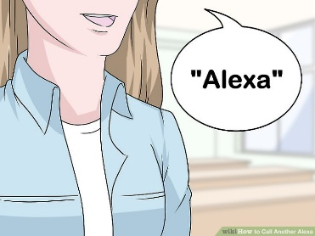
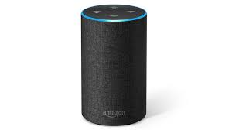
Proposed solution www.Aashayein.in
CHILDREN:
integrate
Story telling BIRBAL ,ISAPNITI
MUSIC: I am Stress Put me sleep HEALING MUSIC.
Tibetiean music
Instrumental music
FEATURE –
VIRTUAL FRIEND ROBOT , ENHANCED VERSION SIGN LANAGUAGE ENABLED ROBOT SPECIAL ABILITIES
Personalized REAL TIME TALK , CONFESSION Hey buddy
BUDDY CHTATBOT TALK TO ME
I am your Friend
SPEECHES:Take me to spiritual Gurus-Integrate You tube , Integrate TED TALK
Take me to ted talkstories-Integrate ted TALKS
FEATURE –
INFORMATION by Area code
List of medical facilities/doctors/Therapist /Social workers organization
A
A
S
H
A
Y
E
I
N
FEATURES
TOOLS
NOTIFICATIN:LOCAL language
You are in crowded place ALERT VIRUS
Wear mask
Sanitize hands after 2 hrs. Hyderate drink water
LFinancial CRISIS Solutions
IST Financial institutions Donors/banks
AASHAYEIN Representative to resolve the case to case basis
PERSONALISED WORKSHOPS
Healthy Meal cook with me
Dance with me
Exercise with me
VIRTUAL TRAVEL
Travel see world Give me virtual world Tour with guide Europe/Australia ,INDIA ,USA

Slide 6
TECHNICAL FLOW VOICE COMMANDS
BROWSER
OUTPUT WWW.AASHAYEIN.IN
USER
AWS
WebSocket
OUTPUT WWW.AASHAYEIN.IN
ROBOT TALK
TOOLS
MUSIC
Voice Api AASHAYEIN
AWS
WebSocket
innovactions,api gateway
Intent based Algo lambada
Intent based Algo lambada
Ashayein does all required navigation and clicking operations required for the user in one go on his voice command or by clicking given by the user dynamically inside the product over diff modules.
Ashayein also has facility required navigation and clicking operations required for the user in one go on his voice command given by the user dynamically inside the product over diff modules.

Slide 7
Production Hosting
AWS ALEXA API skill integration for voice integration commands
Host it on GODDADY
AWS CONTAINER for executing macroservices.
AWS CLOUD VM
DOMAIN registration web space.
Paymentgate way provider
Database mongo db server hosted in container

Slide 8
Benefit
Aashayein is your Friend whom one can talk to give your confession and avaialbe 24/7 for your mind needs
Asheyin can be enhaced for people with special abilities and resolve their issues.
Unlike other voice integrated API which needs to send code on each step “AASHAYEIN” is different as it performs the usual operators transaction in one single go as dyanamic command given by user.
In this pandamic situations aashayein VOICE API can change USER WANT to have all things integrated under one platform shop for mind sustainability.
We can extend the support in local langauge where the app installed will give corrcet notofications
Support will be extended to local education inetgration with teachers.

Slide 9
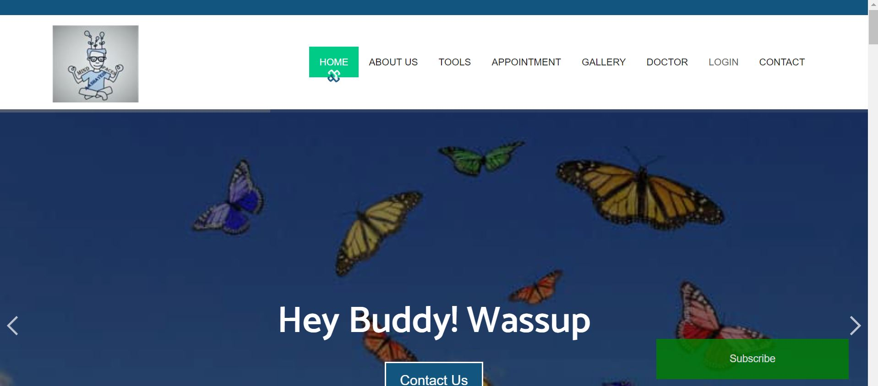

Slide 10
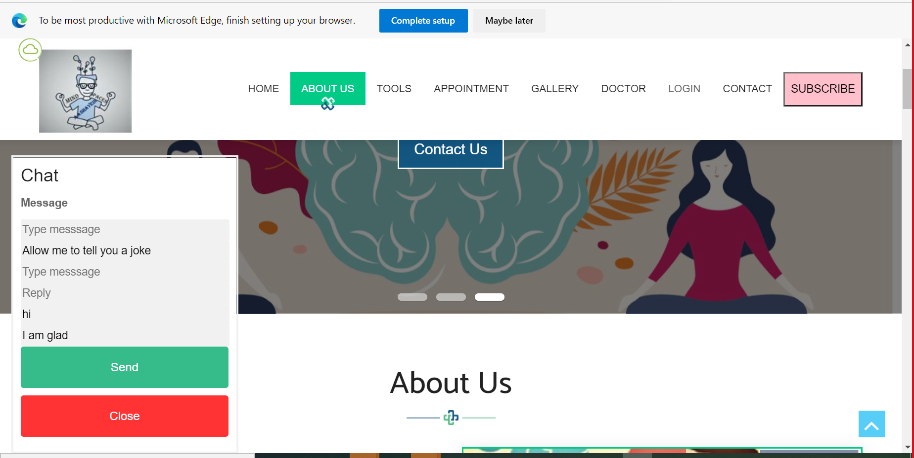
CHAT BOT REAL TIME ROBOT

Slide 11
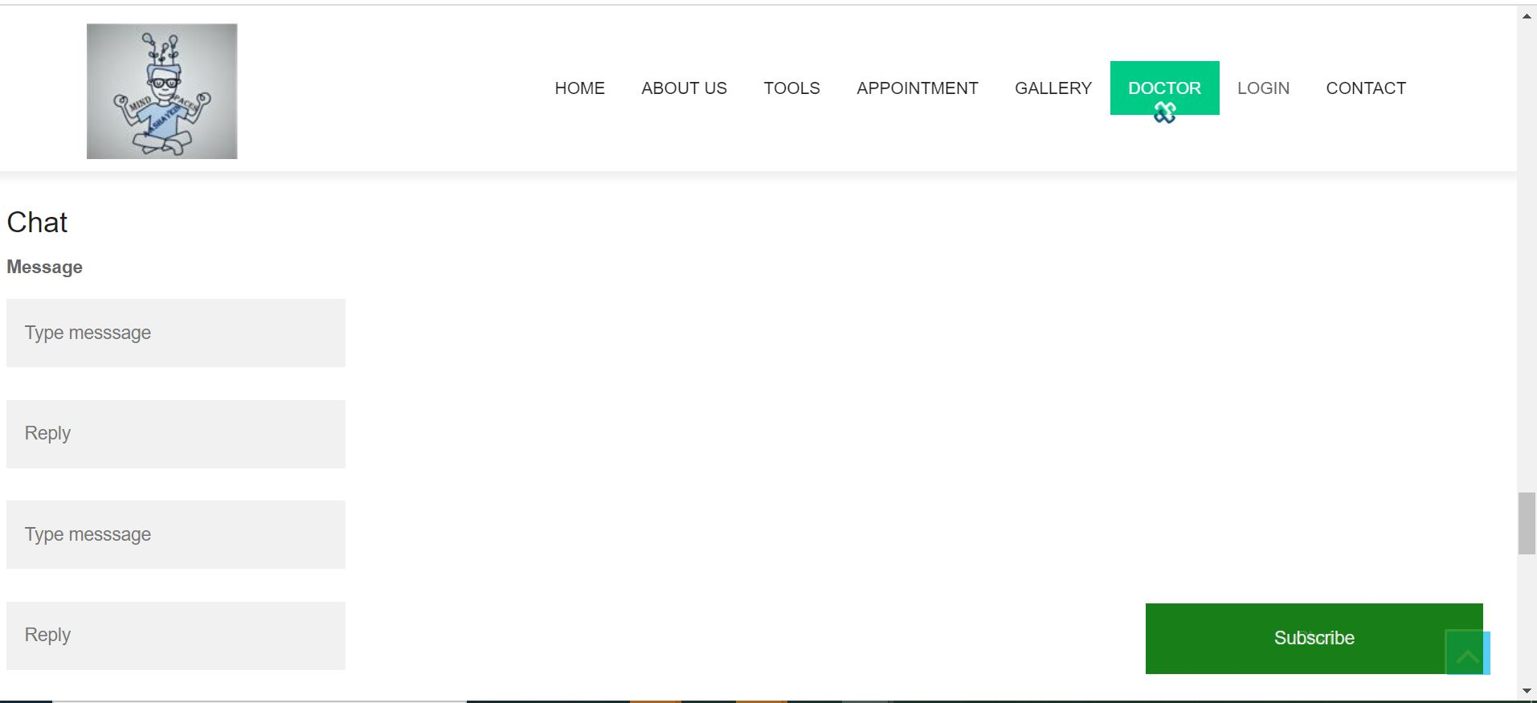
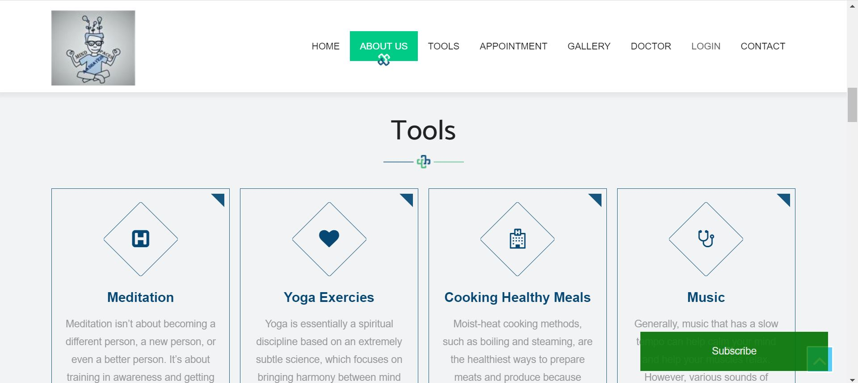
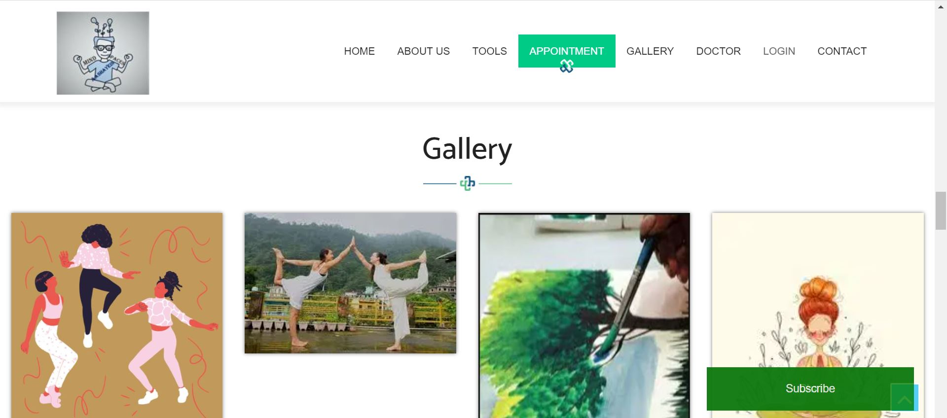

Slide 12
THANK YOU

